Slide 1


Graduation thesis Research on indoor autonomous mobile robot systems using 2D lidar
Supervisor: Cái Việt Anh Dũng, Ph.D
Student: VŨ XUÂN HIỆP | - Student’s ID: 20145413
Student: NGUYỄN CHÍ THÀNH | - Student’s ID: 20145435

Slide 2


TABLE OF CONTENT
01
02
INTRODUCTION
COMPONENT
03
04
KINEMATICS
ODOMETRY
05
06
MAPPING
NAVIGATION
07
RESULTS AND CONCLUSION

Slide 3
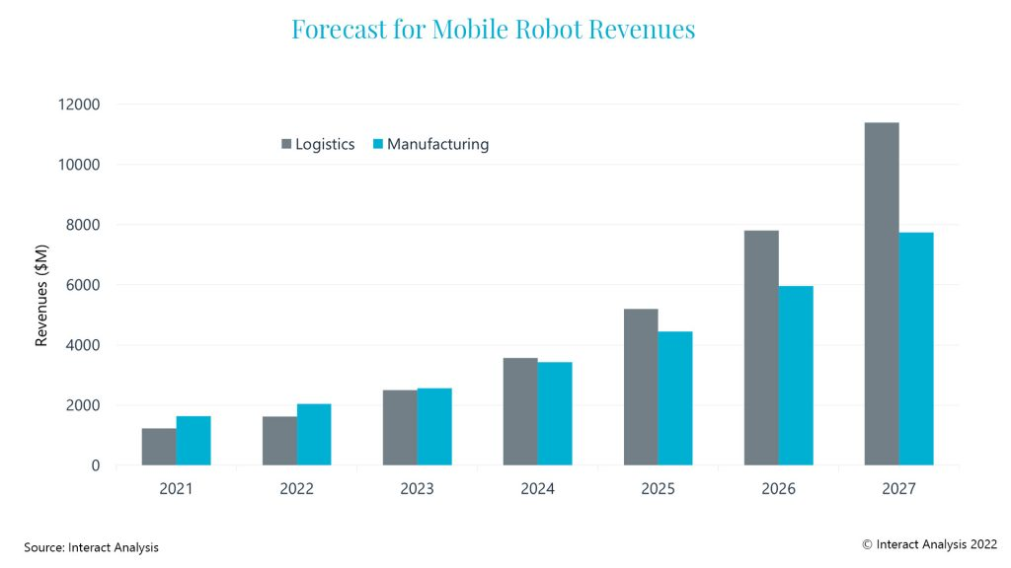
01. INTRODUCTION
Figure 1.1: Forecast for Mobile Robot Revenues[3]

Slide 4
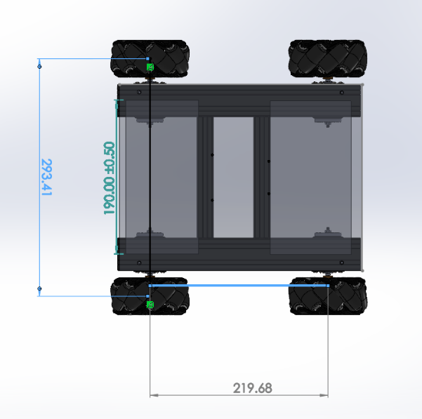
02. COMPONENT - MECHANIC
Chassis specifications
Wheel base | 219.68mm
Wheel track | 239.41mm
Ground clearance | 22mm
Wheel radius | 50mm
Figure 2.1: 3D model of mobile robot

Slide 5
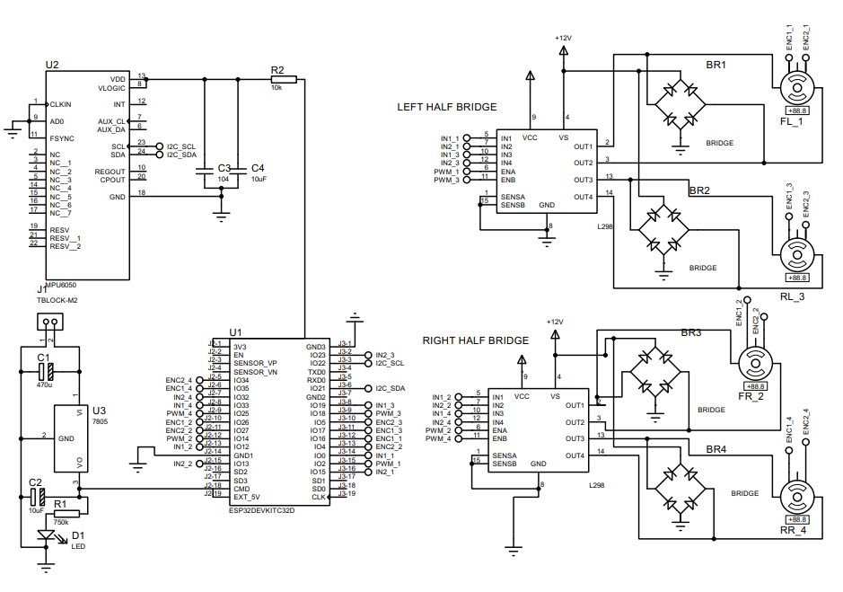
02. COMPONENT - ELECTRIC
Figure 2.2: Circuit schematic

Slide 6
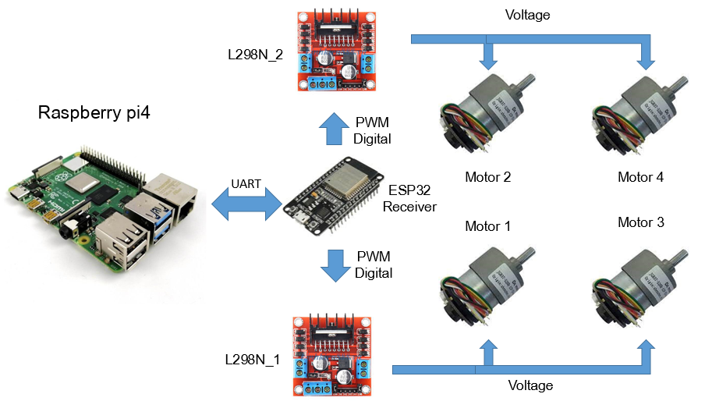
02. COMPONENT - ELECTRIC
Figure 2.3: System hardware architecture

Slide 7
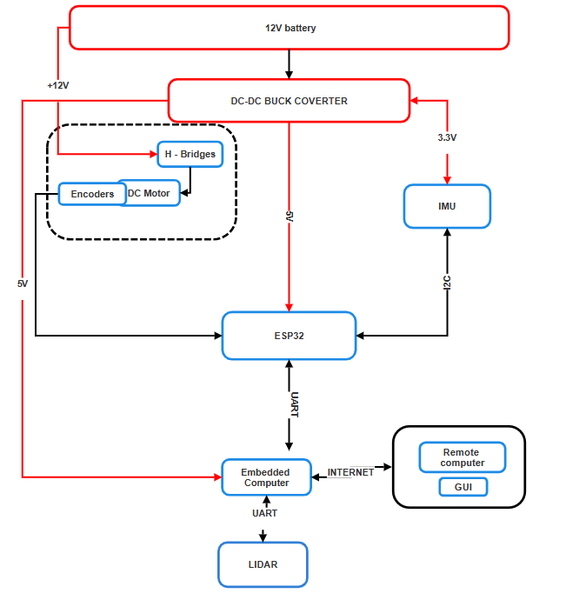
02. COMPONENT - ELECTRIC
Figure 2.4: Electrical block diagram

Slide 8
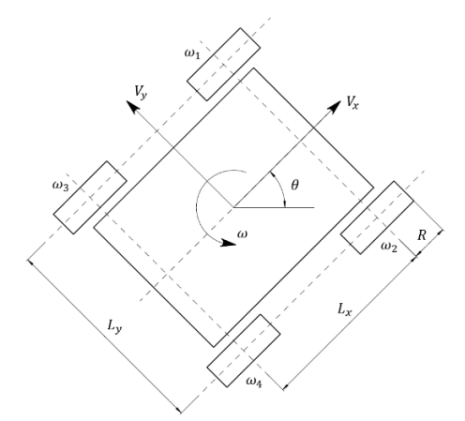
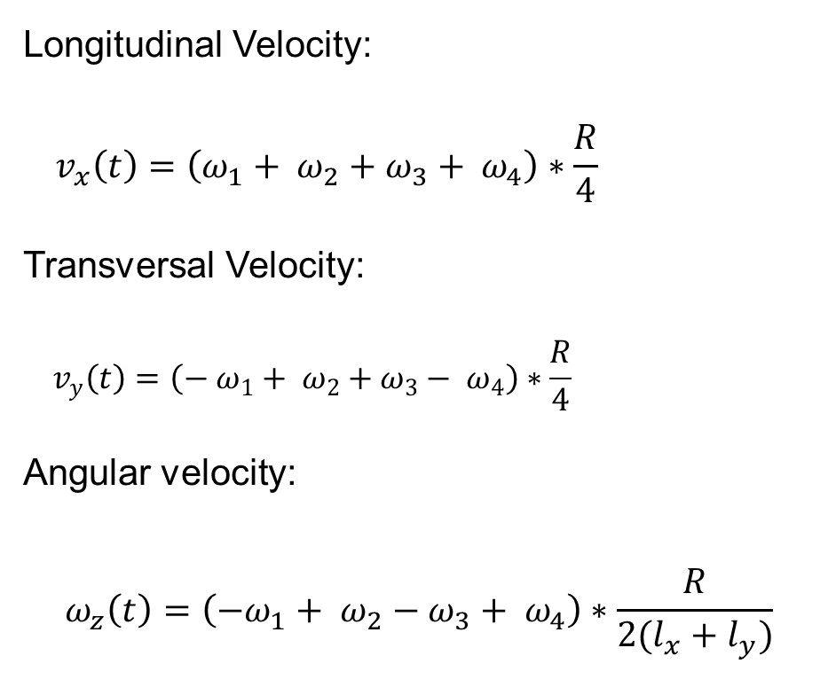
03. KINEMATICS - THESIS
Longitudinal Velocity:
$${ v}_{x}\left(t\right)=\left(ω_{1}+ ω_{2}+ω_{3}+ ω_{4}\right)∗\frac{R}{4}$$
Transversal Velocity:
$${ v}_{y}\left(t\right)=\left({− ω}_{1}+ ω_{2}+ω_{3}− ω_{4}\right)∗\frac{R}{4}$$
Angular velocity:
$$ω_{z}\left(t\right)=\left({−ω}_{1}+ ω_{2}−ω_{3}+ ω_{4}\right)∗\frac{R}{2(l_{x}+l_{y})}$$
Figure 3.1: Calculation scheme of the mathematical model [4]

Slide 9
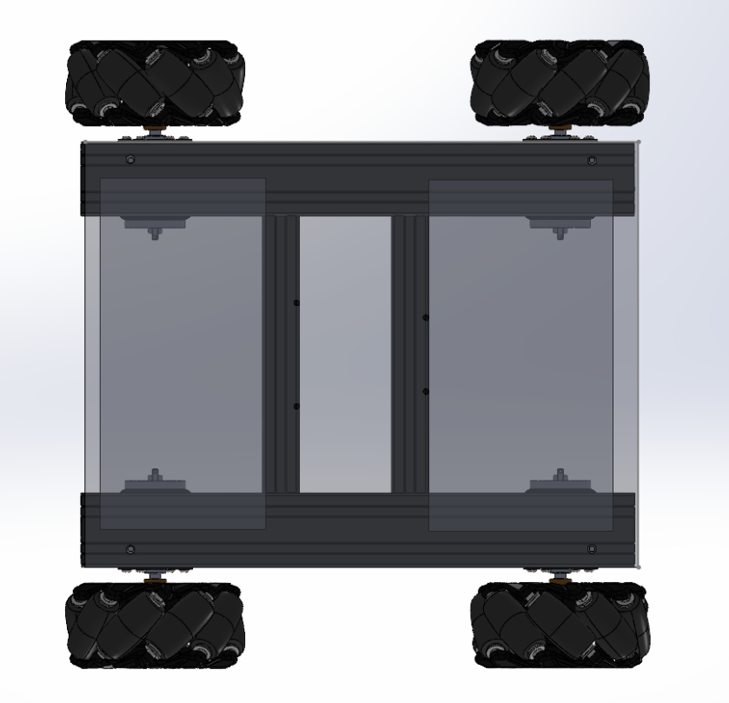
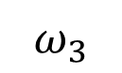
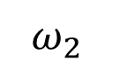
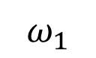
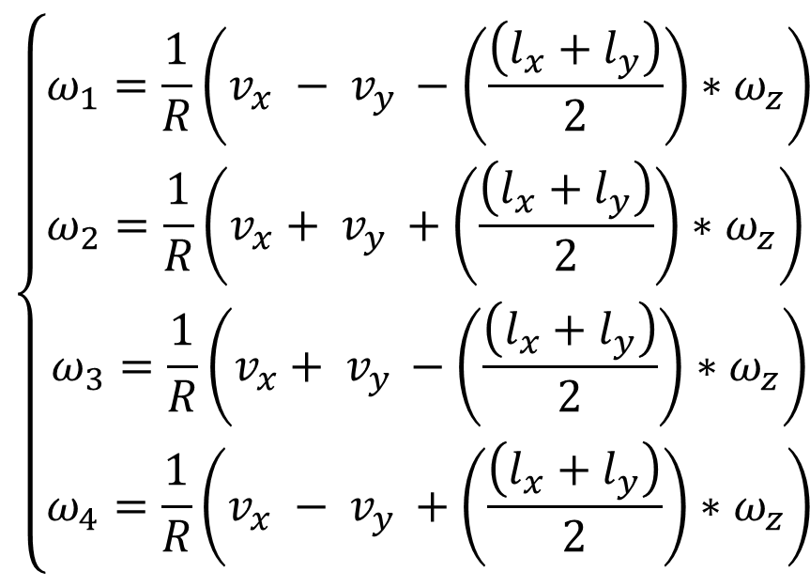
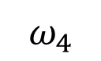
03. KINEMATICS - THESIS
$$\left\{\begin{aligned}&ω_{1}=\frac{1}{R}\left(v_{x} − v_{y }−\left(\frac{\left(l_{x}+l_{y}\right)}{2}\right)∗ω_{z}\right) \\ &ω_{2}=\frac{1}{R}\left(v_{x}+ v_{y }+\left(\frac{\left(l_{x}+l_{y}\right)}{2}\right)∗ω_{z}\right) \\ &\begin{matrix}ω_{3}=\frac{1}{R}\left(v_{x}+ v_{y }−\left(\frac{\left(l_{x}+l_{y}\right)}{2}\right)∗ω_{z}\right) \\ ω_{4}=\frac{1}{R}\left(v_{x} − v_{y }+\left(\frac{\left(l_{x}+l_{y}\right)}{2}\right)∗ω_{z}\right)\end{matrix}\end{aligned}\right.$$
$$ω_{1}$$
$$ω_{2}$$
$$ω_{3}$$
$$ω_{4}$$
Figure 3.2: wheel configuration

Slide 10
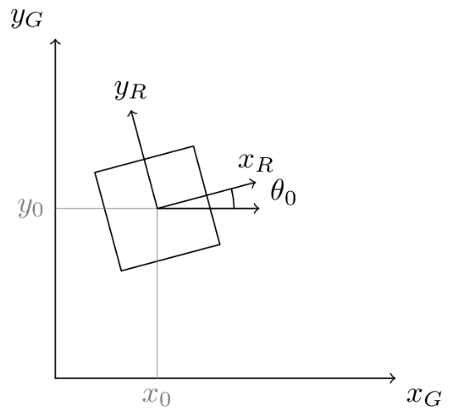
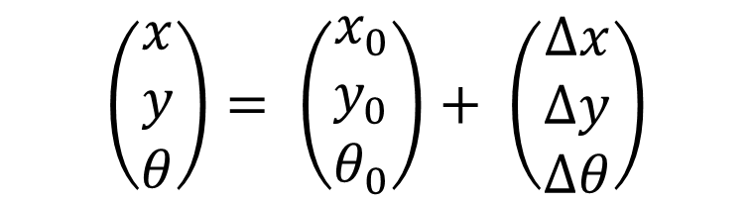
04. ODOMETRY – DEFINITION
$$\left(\begin{matrix}x \\ y \\ θ\end{matrix}\right)= \left(\begin{matrix}x_{0} \\ y_{0} \\ θ_{0}\end{matrix}\right)+ \left(\begin{matrix}∆x \\ ∆y \\ ∆θ\end{matrix}\right)$$
Simply understand, Odometry is finding “where am i” compare to the original position, the process of determining the position and orientation of a robot relative to a starting point
Figure 4.1: Odometry frame [5]

Slide 11
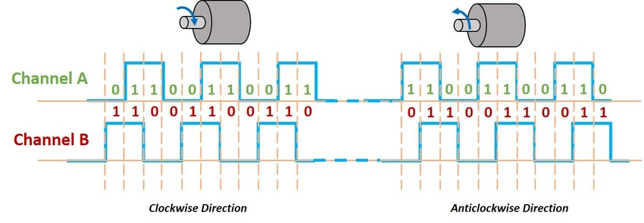
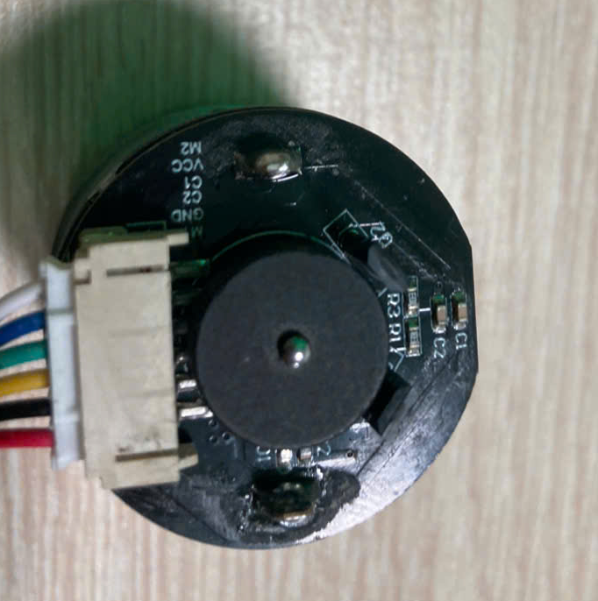
04. ODOMETRY – WHEEL ODOMETRY
Figure 4.2: Channel of hall sensor [6]

Slide 12
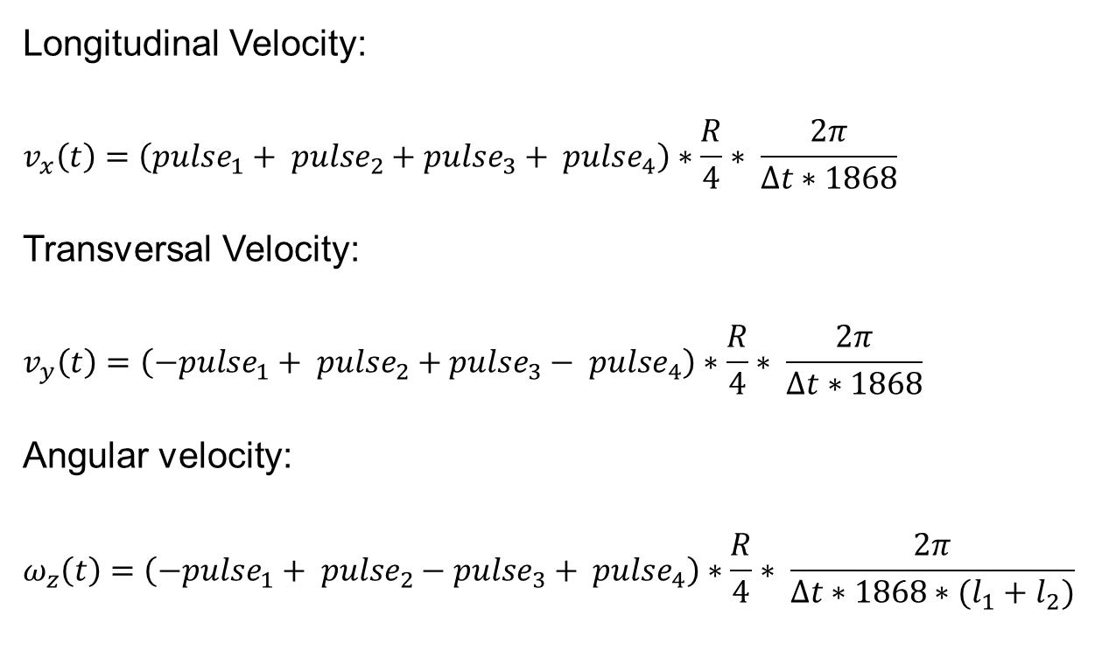
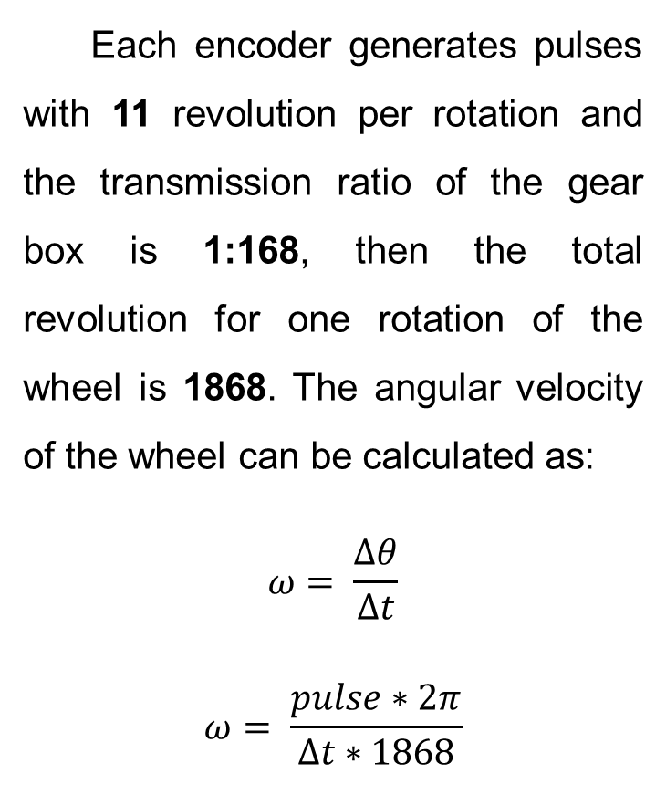
04. ODOMETRY – WHEEL ODOMETRY
Each encoder generates pulses with 11 revolution per rotation and the transmission ratio of the gear box is 1:168, then the total revolution for one rotation of the wheel is 1868. The angular velocity of the wheel can be calculated as:
$$ω= \frac{∆θ}{∆t}$$
$$ω= \frac{pulse∗2π}{∆t∗1868}$$
Longitudinal Velocity:
$$v_{x}\left(t\right)=\left({pulse}_{1}+ {pulse}_{2}+{pulse}_{3}+ {pulse}_{4}\right)∗\frac{R}{4}∗ \frac{2π}{∆t∗1868}$$
Transversal Velocity:
$$v_{y}\left(t\right)=\left(−{pulse}_{1}+ {pulse}_{2}+{pulse}_{3}− {pulse}_{4}\right)∗\frac{R}{4}∗ \frac{2π}{∆t∗1868}$$
Angular velocity:
$$ω_{z}\left(t\right)=\left(−{pulse}_{1}+ {pulse}_{2}−{pulse}_{3}+ {pulse}_{4}\right)∗\frac{R}{4}∗ \frac{2π}{∆t∗1868∗(l_{1}+l_{2})}$$

Slide 13
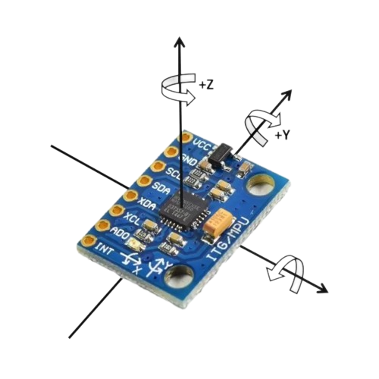
04. ODOMETRY – IMU
Gyro | ω_{x} - Angular velocity about the X-axis
 | ω_{y} - Angular velocity about the Y-axis
 | ω_{y} - Angular velocity about the Z-axis
Accelerometer | a_{x} - Acceleration along the X-axis
 | a_{y} - Acceleration along the Y-axis
 | a_{z}​ - Acceleration along the Z-axis
Figure 4.3: MPU6050

Slide 14
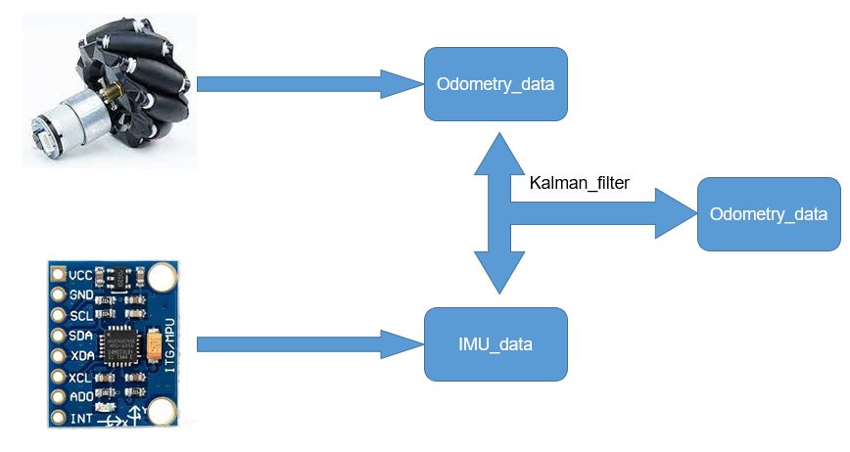
04. ODOMETRY – SENSOR FUSION
Figure 4.4: Sensor fusion for odometry

Slide 15
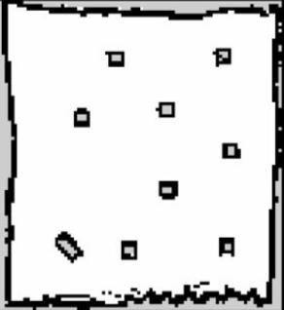
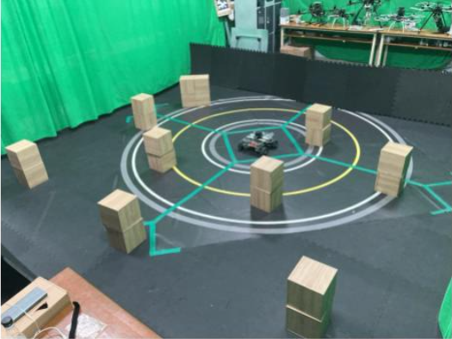
05.MAPPING – OVERVIEW
Figure 5.1: An example of map

Slide 16
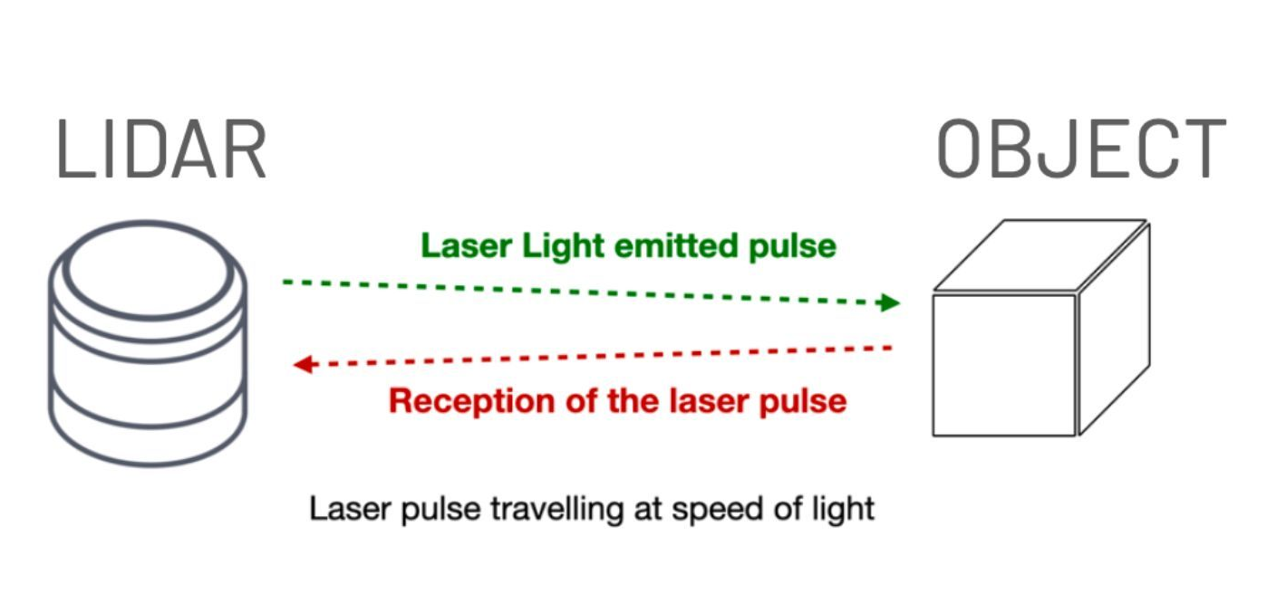
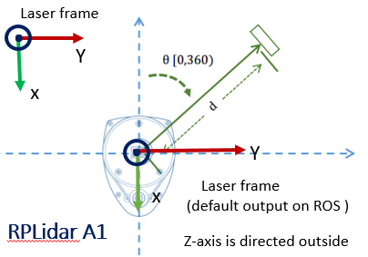
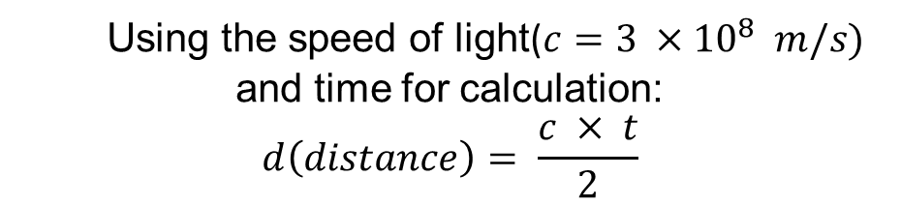
05.MAPPING – 2D-LIDAR
Figure 5.2: Mechanism of lidar [8]
Using the speed of light($c=3 ×{10}^{8} m/s)$ and time for calculation:
$$d\left(distance\right)= \frac{c × t}{2}$$
Figure 5.3: Lidar output [9]

Slide 17
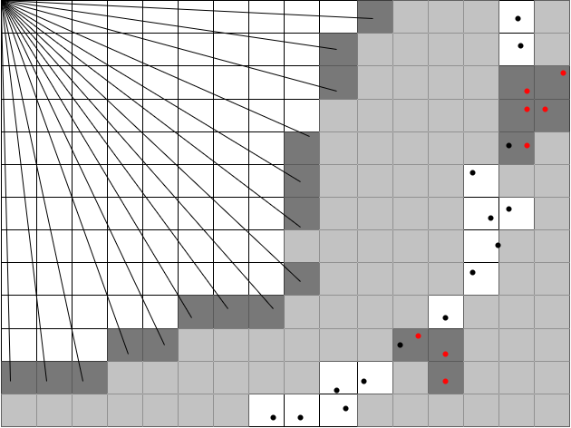
05.MAPPING – OCCUPANCY GRID
Unknown cell
Free cell
Occupied cell
Figure 5.4: Occupancy grid map [10]

Slide 18
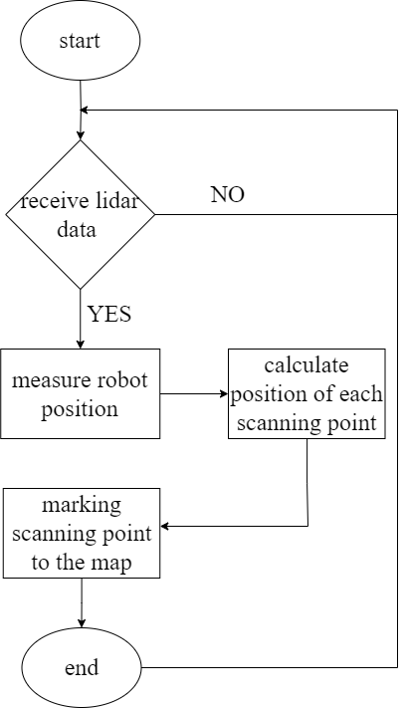
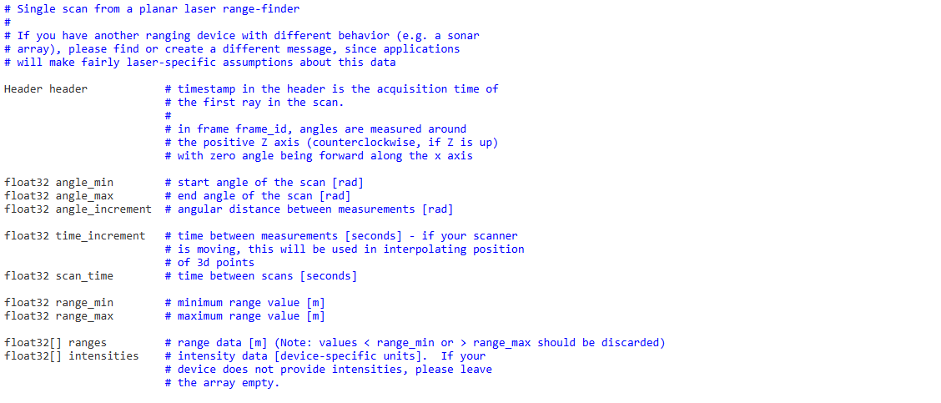
05.MAPPING – PROCESS
Figure 5.5: Mapping flow chart
Figure 5.6: Lidar message [11]

Slide 19
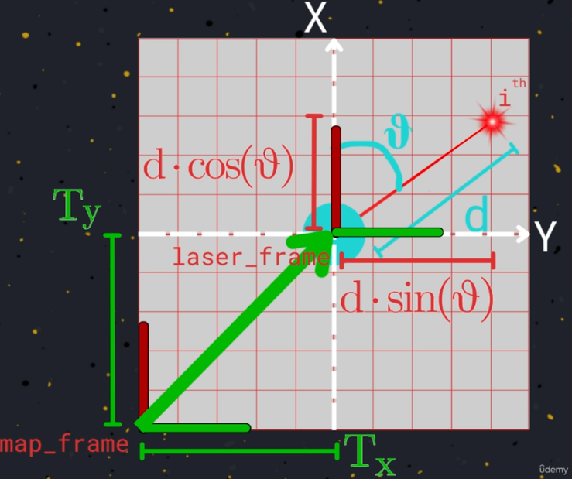
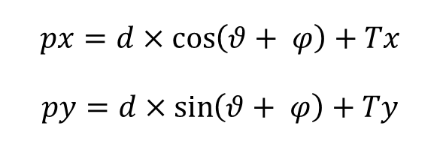
05.MAPPING – PROCESS
Mapping flow chart
Figure 5.7: Lidar message [12]
$$px=d×\cos\left(θ+ φ\right)+Tx$$
$$py=d×\sin\left(θ+ φ\right)+Ty$$

Slide 20
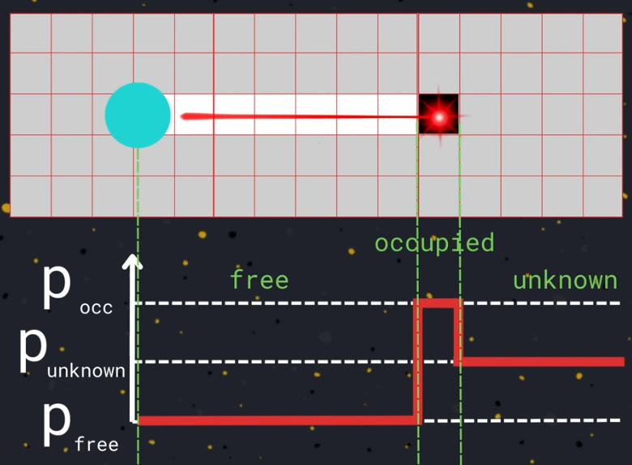
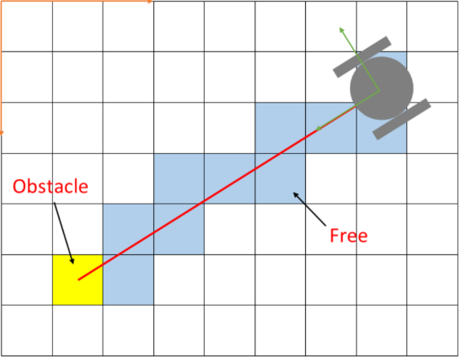
05.MAPPING – PROCESS
Figure 5.8: Marking and Clearing cells
[12]
Mapping flow chart
Figure 5.9: Bersenham’s line [13]

Slide 21
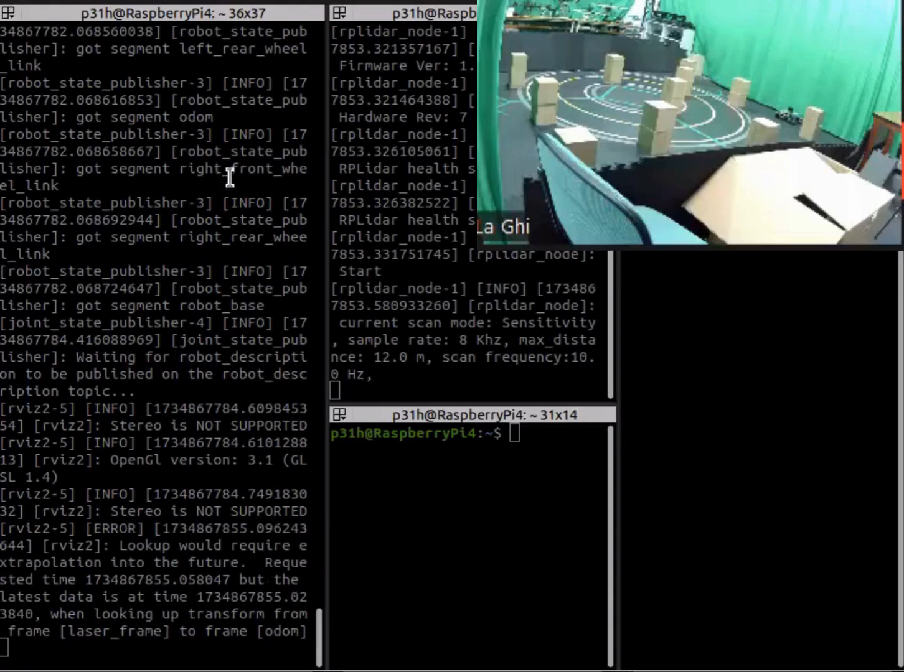
05.MAPPING – PROCESS

Slide 22
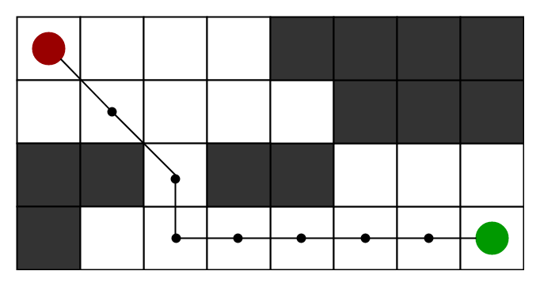
06.NAVIGATION – PATH PLANNING
Figure 6.1: Path planning [14]

Slide 23
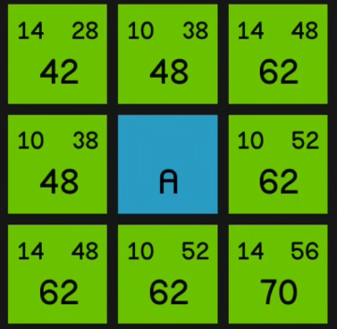
06.NAVIGATION – A* ALGORITHM
h(n): This is the heuristic estimate of the cost from node n to the goal
g(n): This represents the actual cost to reach node n from the start node
f(n): This is the total estimated cost to reach the goal from the current state or node n
f(n) = g(n) + h(n)
Figure 6.2: Evaluation of the next cells [15]

Slide 24
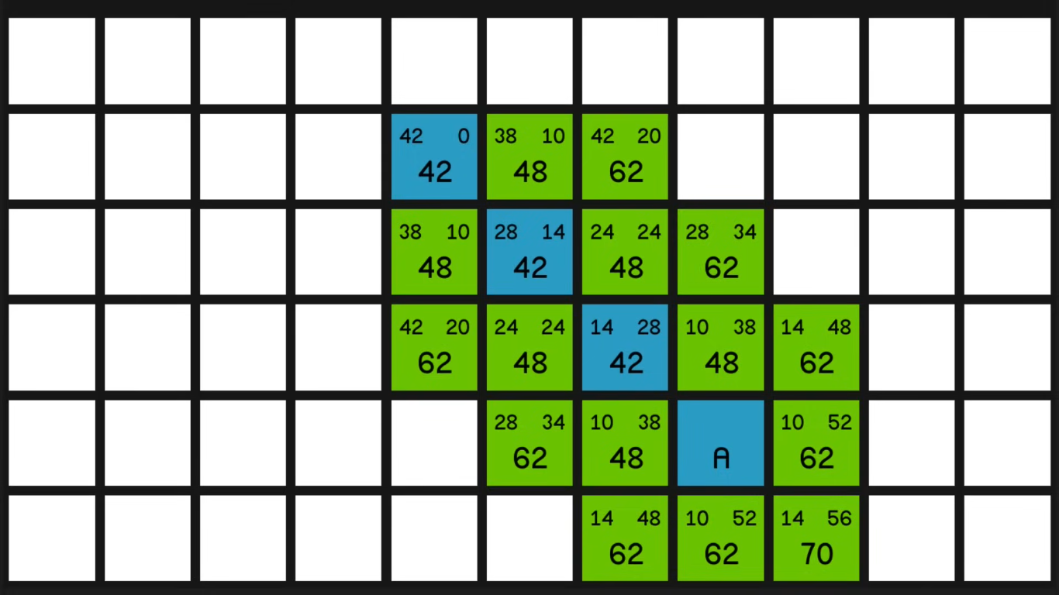
06.NAVIGATION – PATH PLANNING
f(1)-42 = g(1)-14 + h(1)-28
f(2)-42 = g(2)-28 + h(2)-14
f(3)-42 = g(3)-42 + h(3)-0
Figure 6.3: Example of A* algorithm [15]

Slide 25
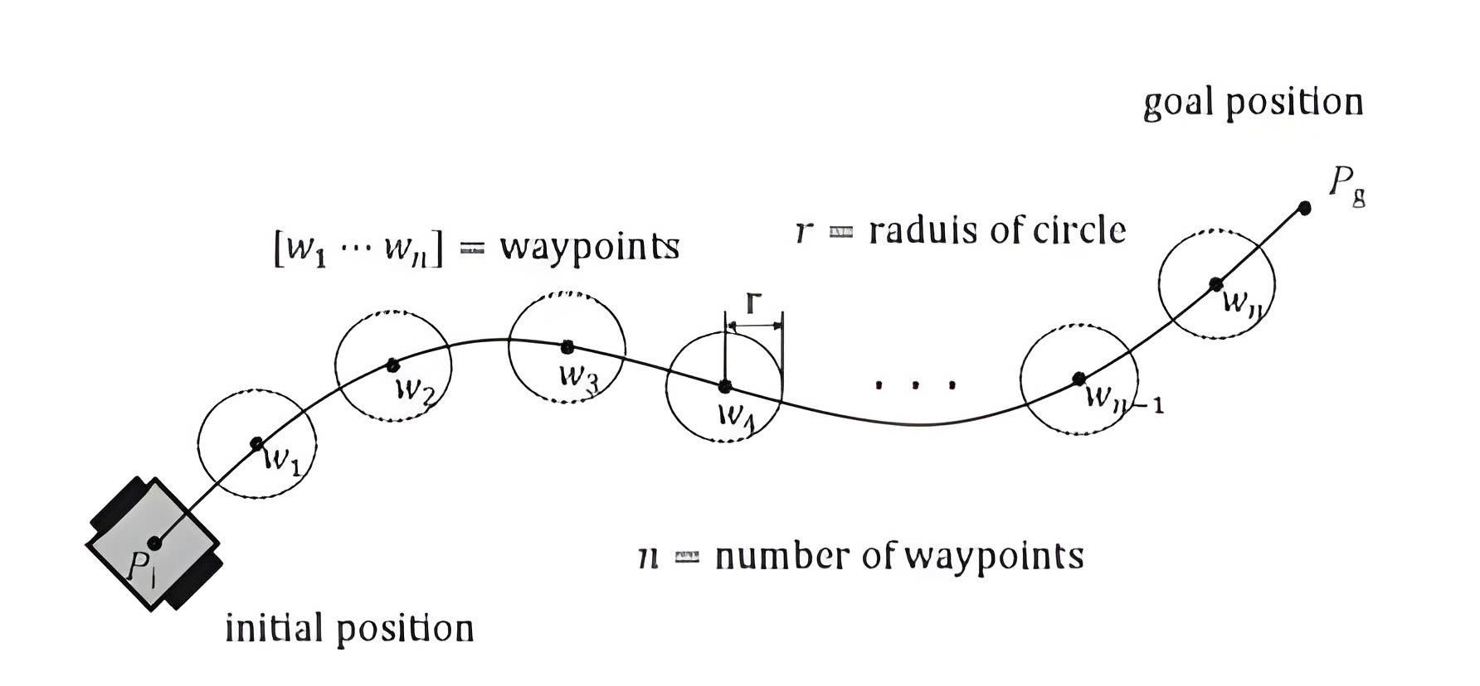
06.NAVIGATION – PATH FOLLOWING
Figure 6.4: Path following [17]

Slide 26
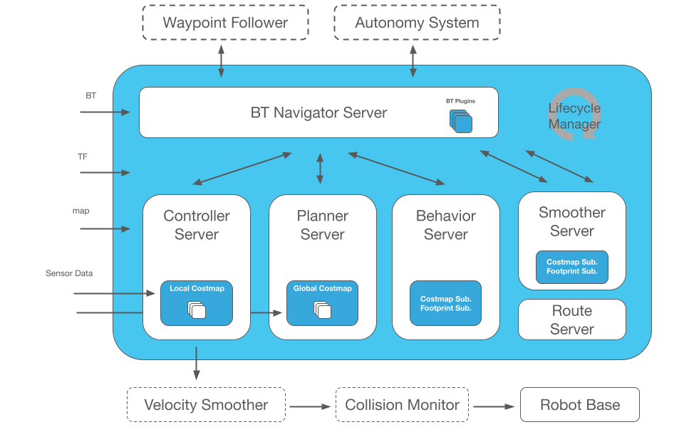
06.NAVIGATION – NAV2
Figure 6.5: Nav2 architecture [16]

Slide 27
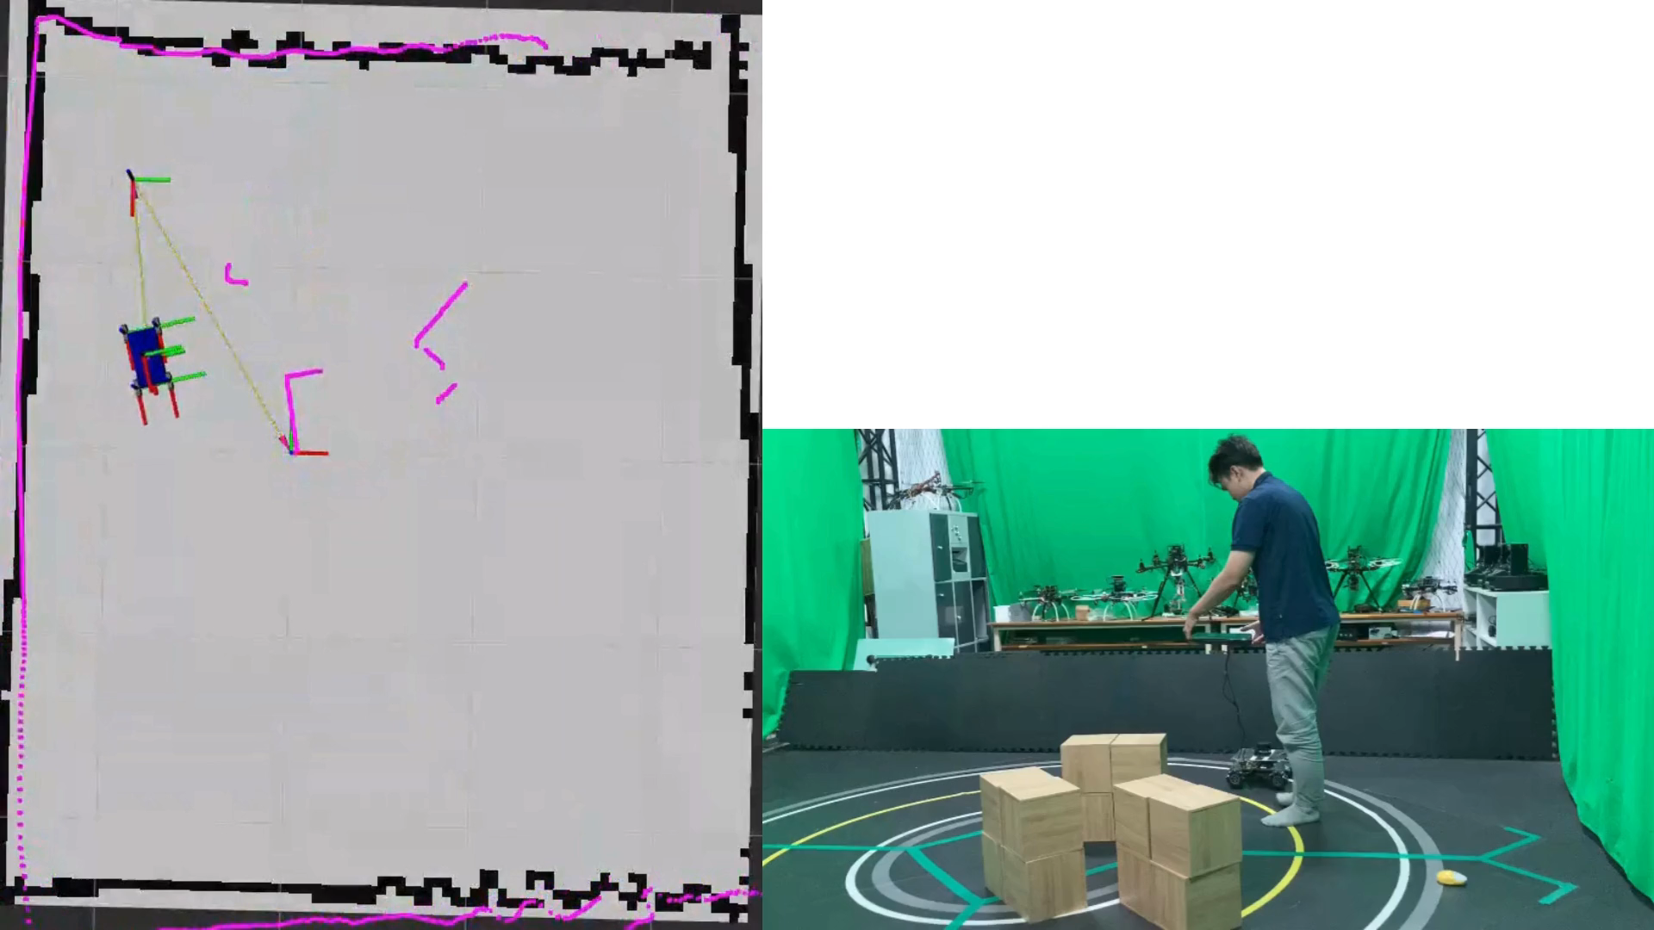
06.NAVIGATION

Slide 28
07.RESULT AND CONCLUSION
ARCHIVEMENT
Scanning and Creating a map of indoor environment setup using 2d lidar
Design a robust mobile robot base for further research
Implement ROS2 and Nav2 for the mobile robot
FURTHER DEVELOPMENT
Develop path planning and path following algorithm
Apply a better version for odometry (Eg: GPS, QR code, Camera)
Build better control system for robot

Slide 29

THANK YOU !

Slide 30
REFERENCE
[1] https://www.youtube.com/watch?v=M32JRrVoVhQ
[2] https://www.youtube.com/watch?v=Ox05Bks2Q3s&t=7s
[3] https://interactanalysis.com/insight/mobile-robot-shipments-grow-by-53-in-2022/
[4] https://www.itmconferences.org/articles/itmconf/pdf/2020/05/itmconf_itee2020_04001.pdf
[5] https://docs.ros.org/en/foxy/Tutorials/Beginner-CLI-Tools/Understanding-ROS2-Services/Understanding-ROS2-Services.html)
[6] https://www.researchgate.net/figure/Quadrature-encoding-with-hall-effect-sensors-Both-channels-will-output-square-waves-that_fig4_342577004)
[8] https://insights.outsight.ai/lidar-technology-a-game-changer/
[9] RPLidarA1M8 datasheet
[10] https://autowarefoundation.github.io/autoware.universe/pr-6268/perception/probabilistic_occupancy_grid_map/laserscan-based-occupancy-grid-map/
[11] https://docs.ros.org/en/noetic/api/sensor_msgs/html/msg/LaserScan.html
[12] https://www.udemy.com/course/self-driving-and-ros-2-learn-by-doing-map-localization/?couponCode=ST12MT122624
[13] httpswww.mdpi.com2076-34171294420
[14] https://www.geeksforgeeks.org/a-search-algorithm/
[15] https://www.youtube.com/watch?v=-L-WgKMFuhE
[16] https://docs.nav2.org/_images/nav2_architecture.png
[17] https://www.researchgate.net/figure/Path-following-method-of-mobile-robot-using waypoints_fig1_289084212

